Slide 1


PROJECT
PRESENTATION
TEAM:
Gautham R - 21BCE6159
Mohamed Riyaas R - 21BCE5828
Omprakash - 21BCE1950
GUIDE:
Dr. Sherly Alphonse

Slide 2
WARLENS – TRANSFER LEARNING FOR EVENT
Classification in Conflict Zones
IMAGE CLASSIFICATION

Slide 3

BACKGROUND
Conflict zones are environments where accurate event classification is critical for timely decision-making and humanitarian response. Traditional machine learning models require vast amounts of labeled data, which is often scarce in such regions due to the difficulty of data collection. WarLens proposes a novel approach utilizing transfer learning to classify events in conflict zones, leveraging pre-trained models on publicly available datasets and fine-tuning them using limited conflict-specific data. This research aims to demonstrate the effectiveness of transfer learning in improving classification accuracy and reducing the need for large annotated datasets.

Slide 4

PROBLEM STATEMENT
WarLens tackles the challenge of data scarcity in conflict zones, where traditional models falter due to limited labeled data, safety concerns, and the fluid nature of conflicts. It also addresses the need for domain adaptation, as models must generalize across diverse conflict environments. Additionally, ethical concerns like bias, misuse risks, and transparency in AI decision-making are key considerations in its implementation.

Slide 5

COLLECTION & Preprocessing Phase
We are using a Kaggle dataset name war events with over 84,151,000 images which are having various types like, combat, humanatarian ai and military vehicles and weapons.
1.
The images will be preprocessed by resizing, normalizing, augmenting, denoising, adjusting contrast, detecting edges, converting color space, cropping, batch normalizing, and whitening data. These steps will enhance data quality, promote model generalization, and improve convergence during neural network training, ensuring robust and efficient performance across various computer vision tasks.
2.
Resize images to a specified target size. Normalize pixel values to a specific range. Apply augmentation techniques such as flipping, shifting, zooming, or shearing.
Apply denoising filters to reduce noise in the images. Convert images from one color space to another, image cropping and Apply batch normalization to the input of each layer.
3.

Slide 6

DATA SOURCES & QUALITY REPORT
1
2
For WarLens, data will be collected from various sources, including social media platforms, reputable news agencies, satellite imagery providers, and open source intelligence reports.
Perform manual and automated validation of labels. Use a subset of images for manual verification and employ a model trained on a smaller verified dataset to predict and cross-check labels.

Slide 7
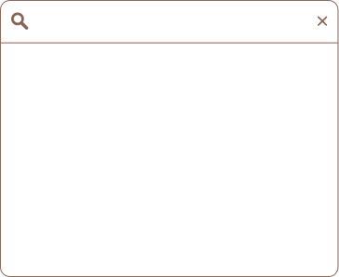
TECH STACK
RESNET 50 MODEL
PYTHON NOTEBOOK IN COLLAB -TENSORFLOW
FULL STACK PROJECT WITH REACT FRONTEND FOR INTERFACE
PYTHON BACKEND WITH FLASK, PILLOW

Slide 8

IMPROVEMENT
The project has a drastic improvement from the initial idea of using MobileNet model, from which the predictions were of very detection rate ranging from 65% to 75% only, showing 90% in accuracy of the model, which were not efficient for the project, as it is very low and project scope expects to have a more accurate model needed, hence we shifted to ResNet 50 which is more powerful than the existing model using MobileNet to improve the overall accuracy rate and decreasing the loss of the model, that improves the model by 75% to 85%, in detection rate, improving the model to 92.5%.

Slide 9
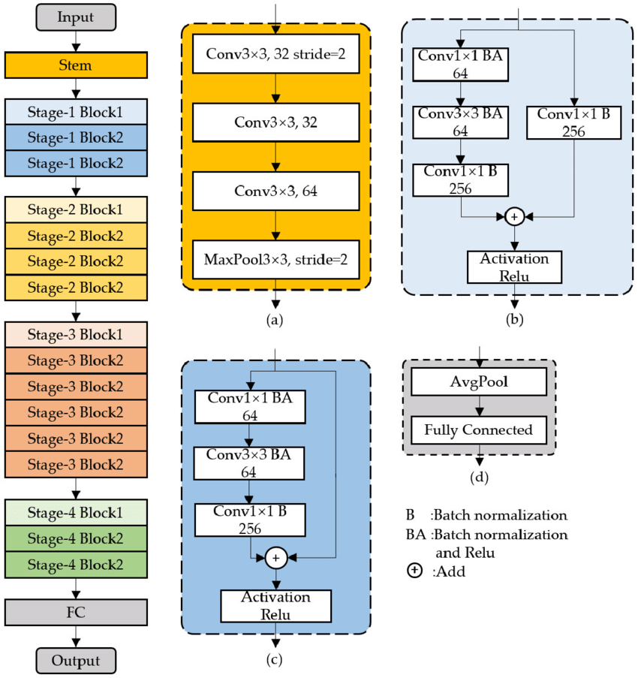
ARCHITECTURE DIAGRAM

Slide 10

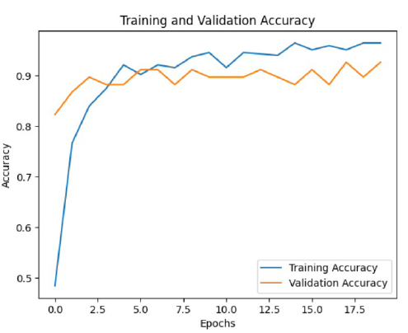

FINAL REFLECTIONS AND FUTURE STEPS
A drastic improvement in the overall model has been experienced in the project, resulting in a better accuracy rate, that uses ResNet 50 model.

Slide 11
THANK YOU.
GET INVOLVED WITH WARLENS
Dr.Abinaya.S
Dr.Sharmila Devi.S

